Slide 1
North Florida FSDO
Runway Safety Program-
Pilot Deviations
Runway Incursions
Instructor and Student Responsibilities…
Risk Management
Teaching Judgment
Pilots and Flight Instructors
Dennis H. Whitley, FAASTeam
2013

Slide 2
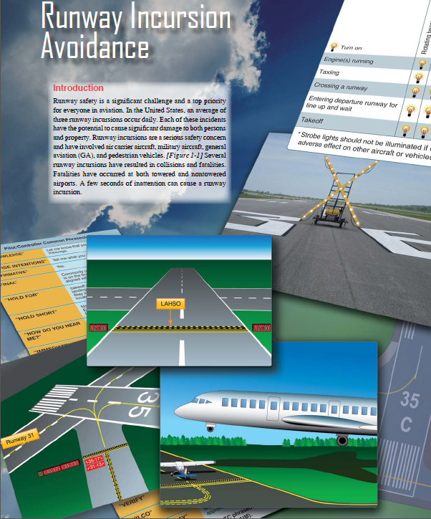

Slide 3
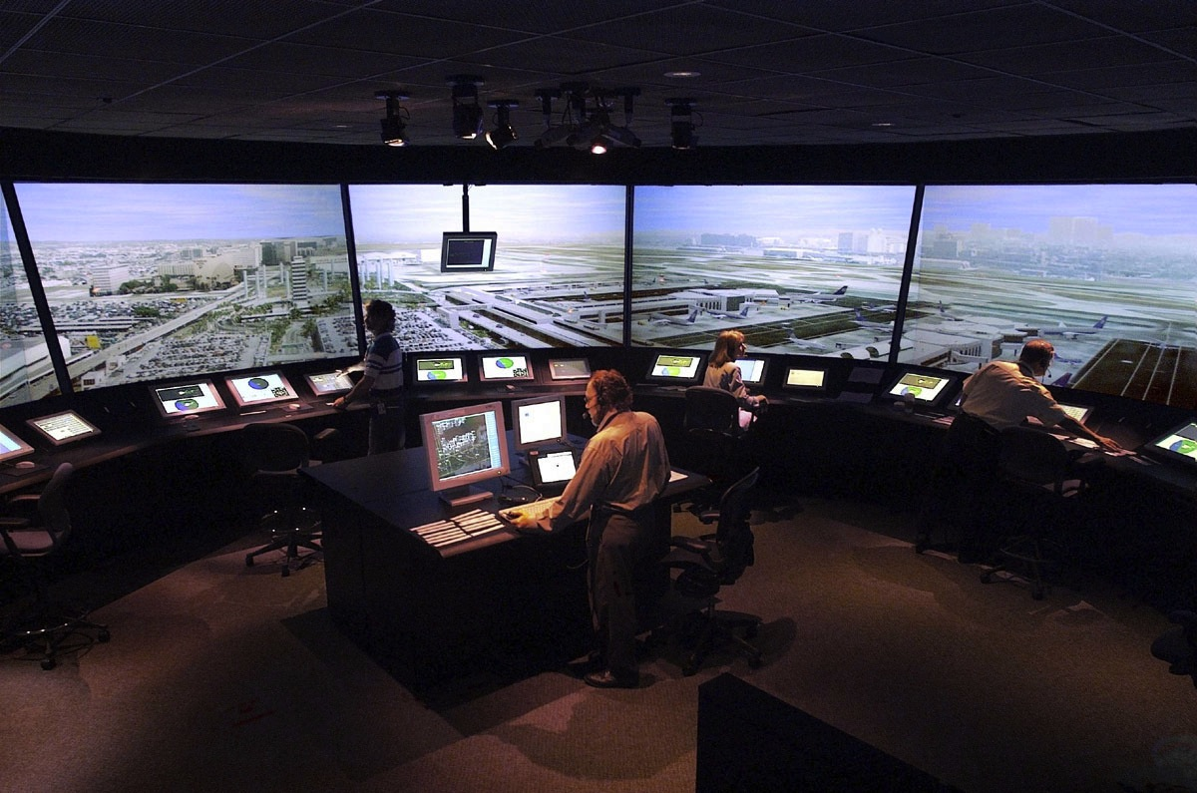
Situational Awareness

Slide 4
Situational Awareness
“The Eye can’t see what the mind doesn’t know!”

Slide 5
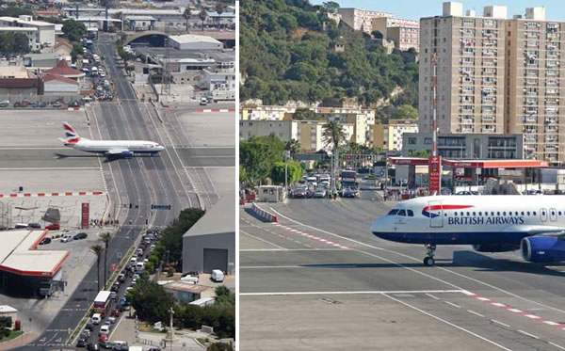
Instructor / Student
Relationships

Slide 6
Pilot and Controller Deviations
Pilot Deviations:
  • Crossing a runway hold marking without clearance from ATC
  • Taking off without clearance
  • Landing without clearance
Operational Incidents (OI):
  • Clearing an aircraft onto a runway while another aircraft is landing on the same runway
  • Issuing a takeoff clearance while the runway is occupied by another aircraft or vehicle
Vehicle (Driver) Deviations:
  • Crossing a runway hold marking without ATC clearance

Slide 7
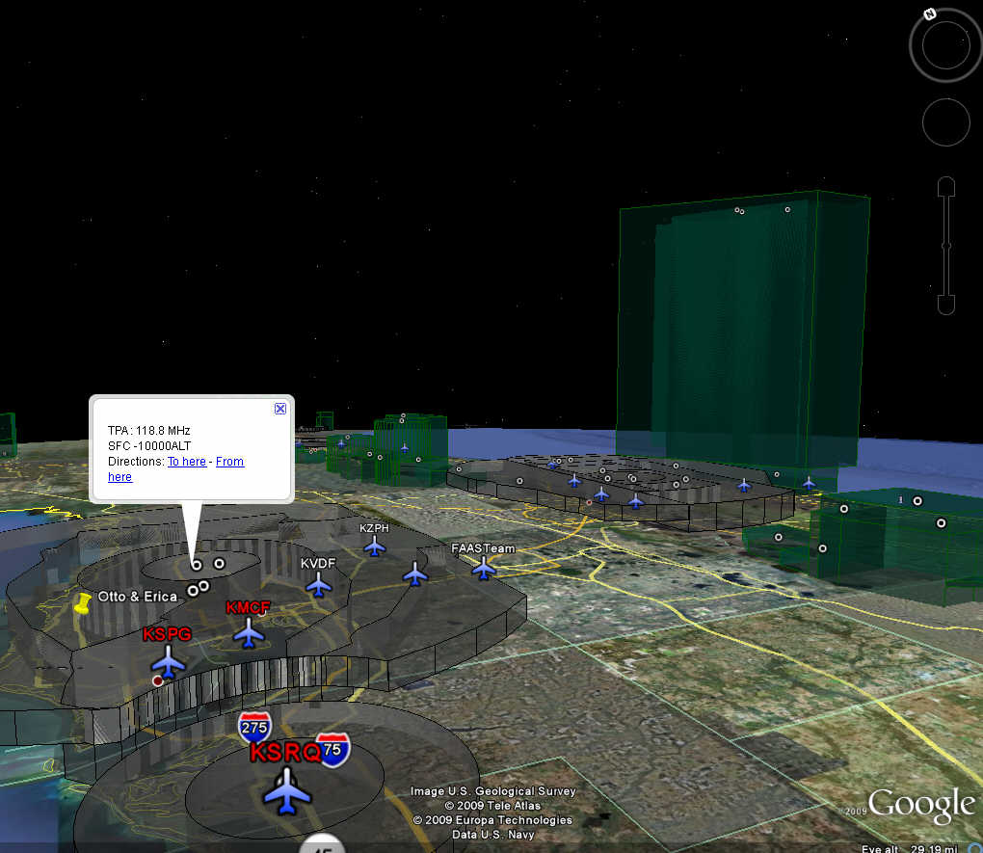
Pilot Deviations

Slide 8
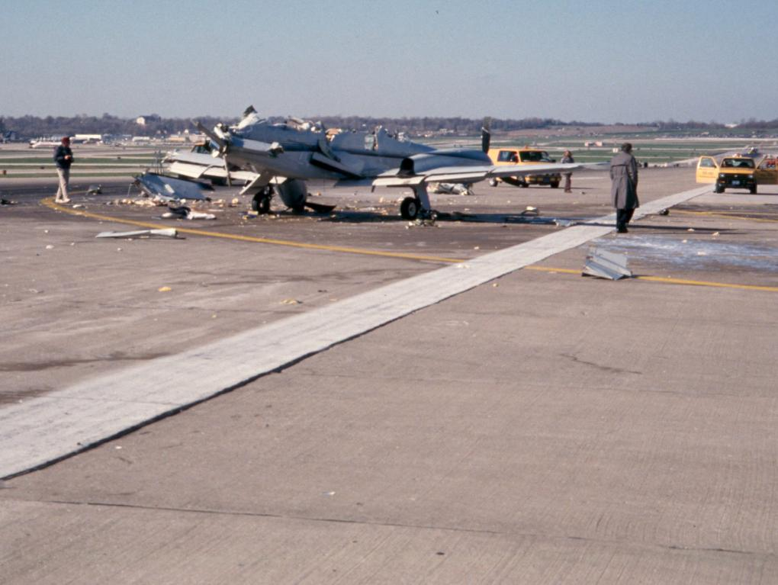
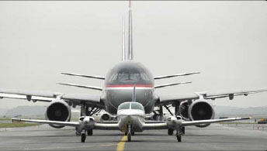
Runway Incursions

Slide 9
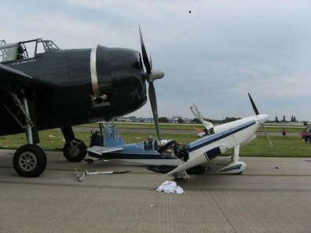
Runway Incursions

Slide 10
Dangerous Mixture

Slide 11
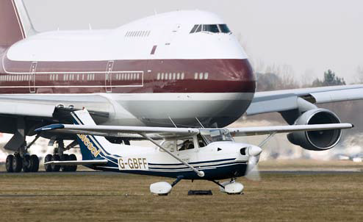
Dangerous Mixture

Slide 12
Airport / Runway Incursions
FY- 2012
REGION | OE/D | OI | OTHER | PD | V/PD | TOTAL
Totals: | 57 | 169 | 2 | 722 | 200 | 1150
AAL |  | 3 |  | 16 | 6 | 25
ACE |  | 2 | 1 | 23 | 5 | 31
AEA | 10 | 33 |  | 72 | 31 | 146
AGL | 9 | 31 |  | 83 | 31 | 154
ANE | 1 | 2 |  | 20 | 2 | 25
ANM | 4 | 14 |  | 57 | 21 | 96
ASO | 9 | 30 |  | 130 | 30 | 199
ASW | 13 | 20 | 1 | 104 | 46 | 184
AWP | 11 | 34 |  | 217 | 28 | 290
Data valid through 15-Jun-2013

Slide 13
Airport / Runway Incursions
FY- 2012
REGION | OE/D | OI | OTHER | PD | V/PD | TOTAL
Totals: | 57 | 169 | 2 | 722 | 200 | 1150
AAL |  | 3 |  | 16 | 6 | 25
ACE |  | 2 | 1 | 23 | 5 | 31
AEA | 10 | 33 |  | 72 | 31 | 146
AGL | 9 | 31 |  | 83 | 31 | 154
ANE | 1 | 2 |  | 20 | 2 | 25
ANM | 4 | 14 |  | 57 | 21 | 96
ASO | 9 | 30 |  | 130 | 30 | 199
ASW | 13 | 20 | 1 | 104 | 46 | 184
AWP | 11 | 34 |  | 217 | 28 | 290
Data valid through 15-Jun-2013

Slide 14
Recent Deviations in the area:
Since October 1, 2012 11 Deviations
9 Runway Incursions
5 Students 4 SRQ 1 VRB
5 Privates 2 SRQ 3 Other
2 Pilot Deviations
2 Commercial 1 SRQ 1 Other

Slide 15
Recent Deviations in the area:
Since October 1, 2012 11 Deviations
Out of the 11 Deviations,,,
NONE
Of the Pilots were registered on FAASafety.gov !!!
Not One !!!

Slide 16
Recent Deviations in the area:
Since October 1, 2012 11 Deviations
30 Pilot Deviations In Tampa

Slide 17
Recent Deviations in the area:
Since October 1, 2012 11 Deviations
Out of the 30 Deviations,,,
ONE
Of the Pilots was registered on FAASafety.gov !!!
Only One !!!

Slide 18
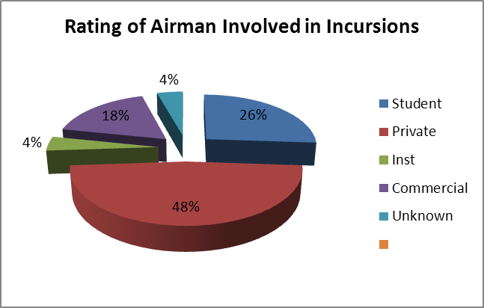
Airport / Runway Incursions

Slide 19
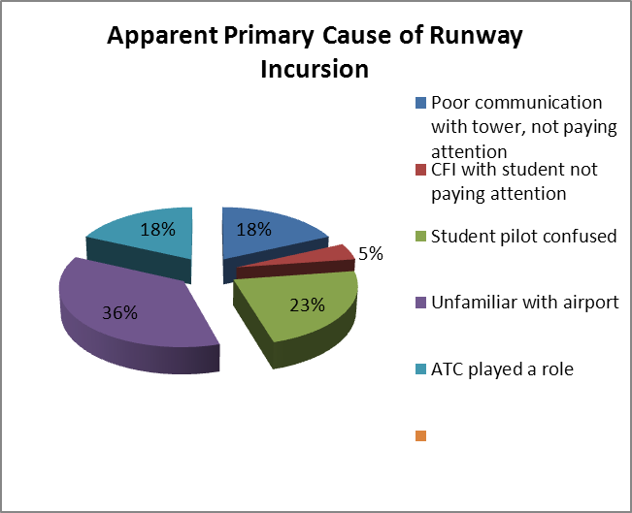
Airport / Runway Incursions

Slide 20
Runway Incursion Causal Categories
OPERATIONAL ERROR (OE) - A human error caused by a tower controller. There are over 8000 tower controllers in the U.S.
PILOT DEVIATION (PD) - A human error caused by a pilot. There are over 675,000 licensed pilots in the U.S.
VEHICLE/PEDESTRIAN DEVIATION (V/PD) - A human error caused by a vehicle operator or pedestrian which results in an entry onto the movement area that has not been authorized by ATC.

Slide 21
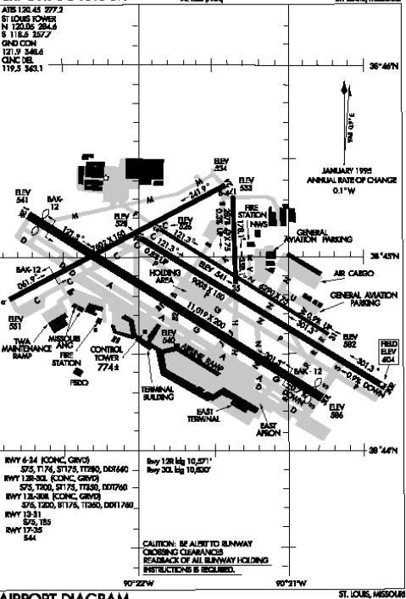
Genesis of a Incursion
A safety hazard/ runway incursion is likely to occur when the exact location of an aircraft or vehicle on the airport surface in relation to a specific ATC clearance is unknown.
PILOTS and VEHICLE OPERATORS must taxi and maneuver their aircraft/vehicles on taxiways and runways in accordance with ATC instructions.
CONTROLLERS must monitor the location and progression of the aircraft and vehicles operating on the airport surface, in accordance with instructions issued, to provide separation assurance.

Slide 22
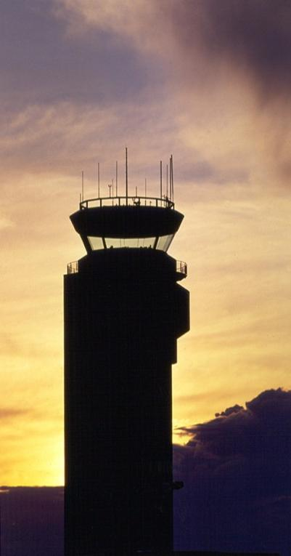
Operational Error (OE)
CONTROLLERS are at risk of being a party to an incursion when they are unable to correlate their visual observations of the aircraft/vehicle location with previously issued ATC instructions.
Some contributing factors include:
-FAILURE TO FOLLOW ESTABLISHED STANDARDIZED PROCEDURES
-FAILURE TO UNDERSTAND THE IMPLICATIONS OF THEIR ACTIONS OR INACTIONS
-LACK OF TRAINING & PRACTICE TO INTERNALIZE PROCEDURES
-LOSS OF SITUATIONAL AWARENESS

Slide 23
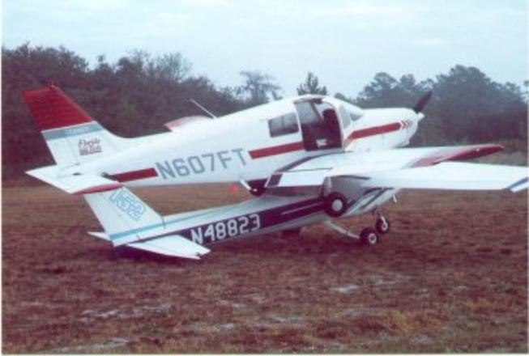
Pilot Deviation (PD)
PILOTS are at risk of being a party to an incursion when they are unable to correlate their visual observations of airport signs, markings and lighting and other physical features on the airport with the specific ATC taxi instructions.
Some contributing factors include:
-FAILURE TO ASK FOR HELP WHEN CONFUSED
-FAILURE TO USE THE AIRPORT DIAGRAM
-LACK OF TRAINING
-NOT FAMILIAR WITH THE AIRPORT

Slide 24
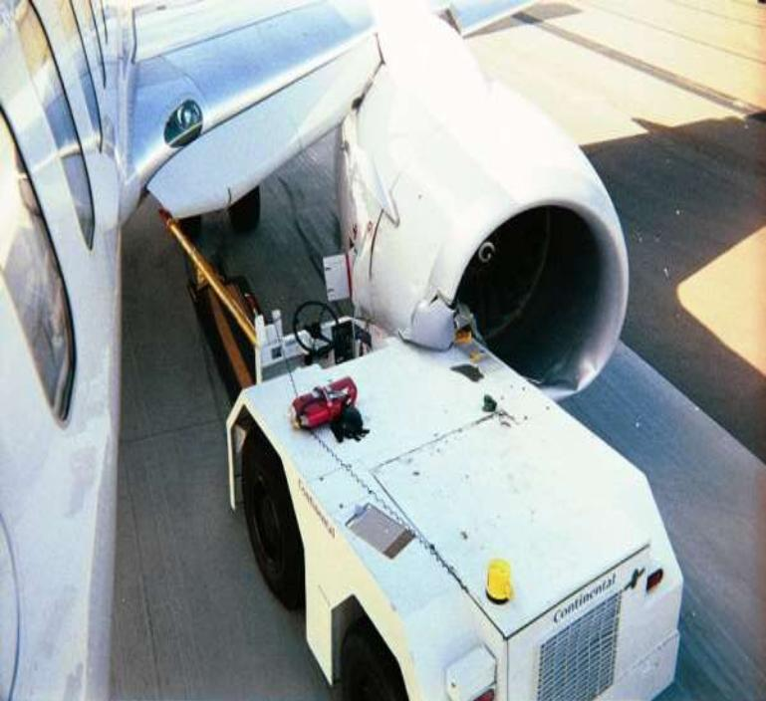
Pedestrian Deviation (V/PD)
VEHICLE OPERATORS and PEDESTRIANS are at risk of being a party to an incursion when they are unable to correlate their visual observations of airport signs, markings and lighting and other physical features on the airport with the specific ATC taxi instructions.
Some contributing factors include:
-FAILURE TO ASK FOR HELP WHEN CONFUSED
-FAILURE TO USE THE AIRPORT DIAGRAM
-LACK OF TRAINING
-NOT FAMILIAR WITH AIRPORT

Slide 25
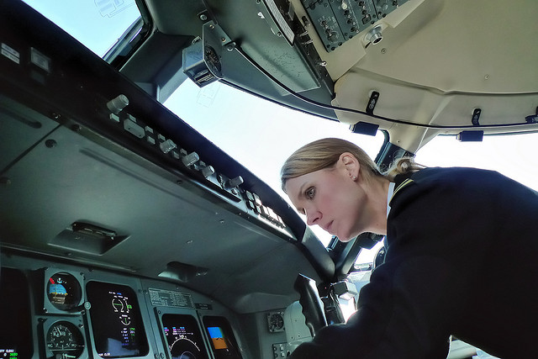
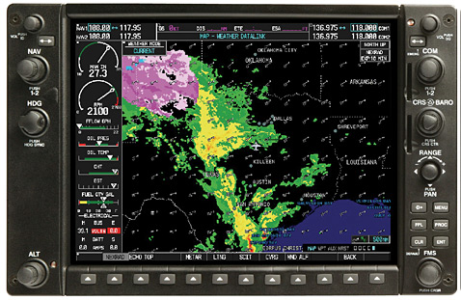

Distractions
Distractions: Distractions are the main threat facing flight crews. Some contributing factors include:
-INABILITY TO MULTITASK
-TUNNEL VISION
-UNFAMILARITY WITH EQUIPMENT
-HEADS DOWN TOO LONG
-UNAUTHORIZED EQUIPMENT

Slide 26
What is being done to achieve a safer flying environment?

Slide 27
What is being done to achieve a safer flying environment?
Upgrade Airport Markings at Medium and Large Airports
Upgrade Airport Markings at Smaller Airports
Airport Recurrent Training
Airport Surface Analysis
Air Carrier Pilot Training
Air Carrier Cockpit Procedures
Air Traffic Procedures
FAA Air Traffic Organization (ATO) Voluntary Reporting
Reducing Pilot Deviations
Background on Runway Incursions

Slide 28
Known 'Best Practices' for
AIRFIELD SAFETY
Encourage use of correct terminology and proper voice cadence.
Eliminate distractions in the operational area.
Obtain and use airport diagrams. Use the FAA runway safety website to find airport diagrams for all airports.
Conduct "Clearing Turns" prior to entering ANY runway.
Maintain a sterile cockpit when taxiing.
Maintain appropriate Taxi speed.
Encourage pilots to have their "eyes out" when taxiing.
Encourage pilots to have a "heads up" policy when taxiing.
Attend safety seminars and programs on RUNWAY SAFETY.
Improve safety by teaching, advocating, stressing and understanding situational awareness.

Slide 29
Known 'Best Practices' for
AIRFIELD SAFETY
Customize RUNWAY SAFETY presentations for targeted audiences such as pilot organizations, safety seminars, airport authorities, etc.
Cite specific airport RUNWAY SAFETY web pages.
Distribute RUNWAY SAFETY materials to every aviation entity.
Package and distribute runway safety materials to: Flight Schools, Flight Safety International, Maintenance Centers, Aircraft Manufacturers, etc.
Realize that every airport is unique and presents its own set of RUNWAY SAFETY challenges.
Stay alert; stay alive.
Declare war on errors; make it everyones’ responsibility.

Slide 30

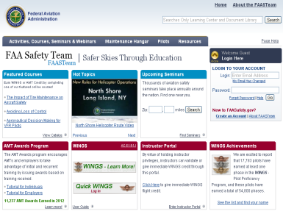
What else is being done to achieve a safer flying environment?

Slide 31
What else is being done to achieve a safer flying environment?
Continuing Education !!!
FAASafety.GOV
&
The FAASTeam

Slide 32
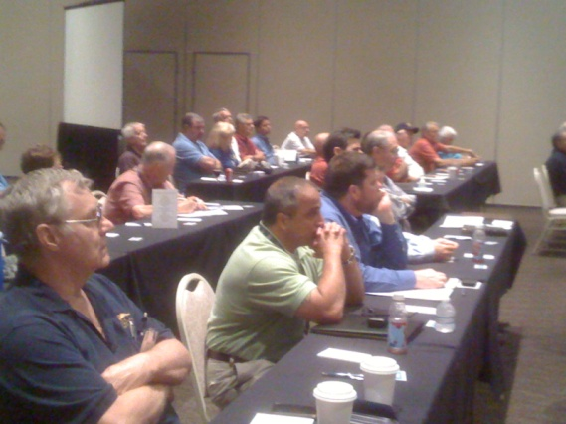
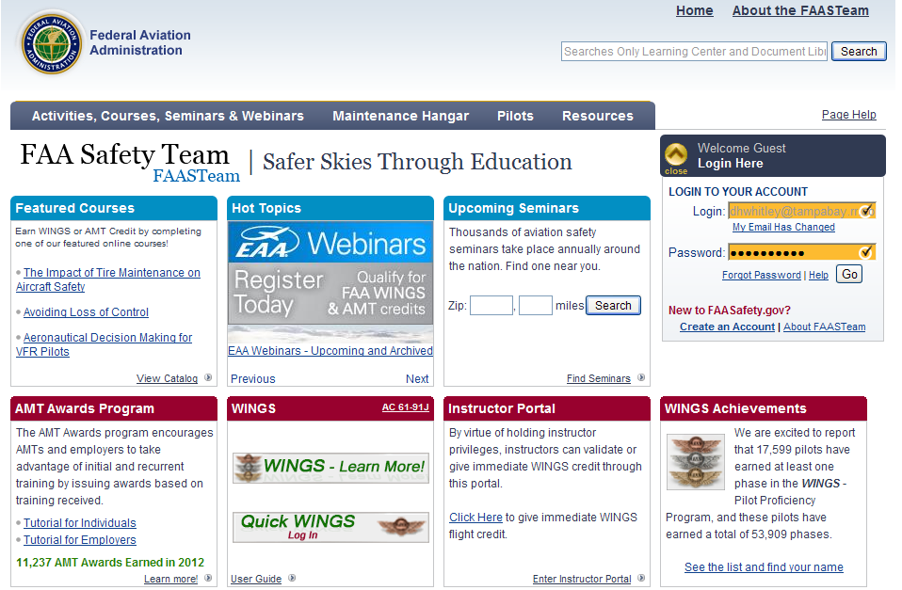
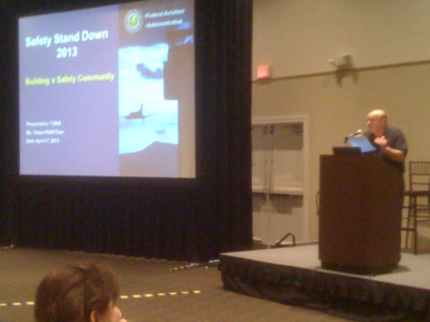
FAASTeam Safety Seminars
On Line Courses
Seminars like the very one
you are attending this evening.

Slide 33

Thank You For Attending
Our Program.

Slide 34
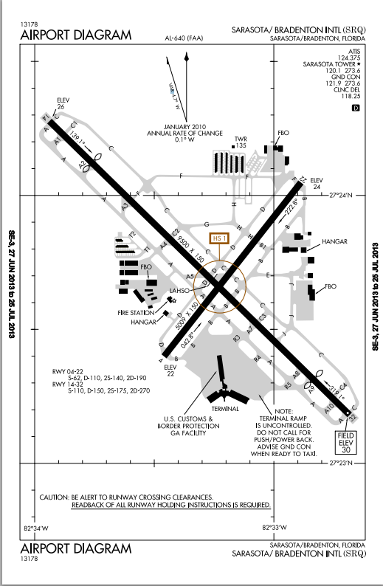

Slide 35
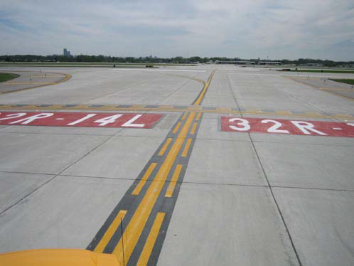

Slide 36
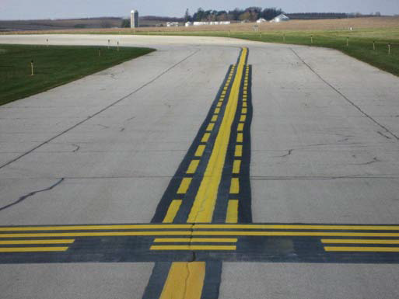

Slide 37
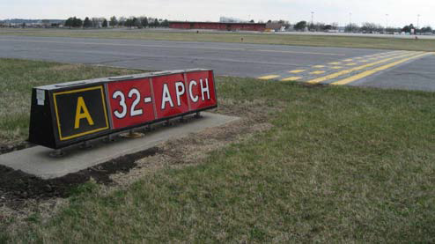

Slide 38
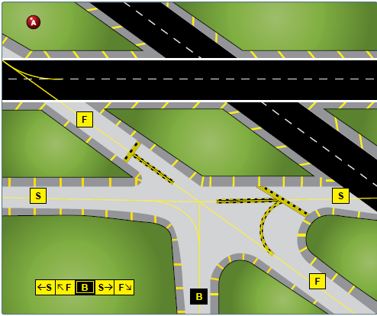

Slide 39
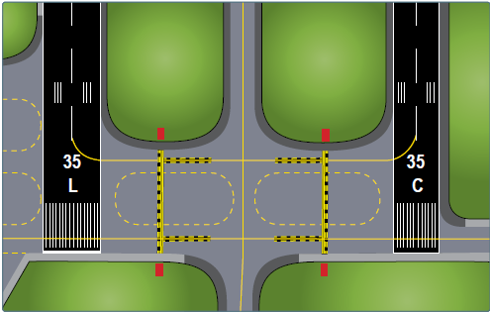

Slide 40
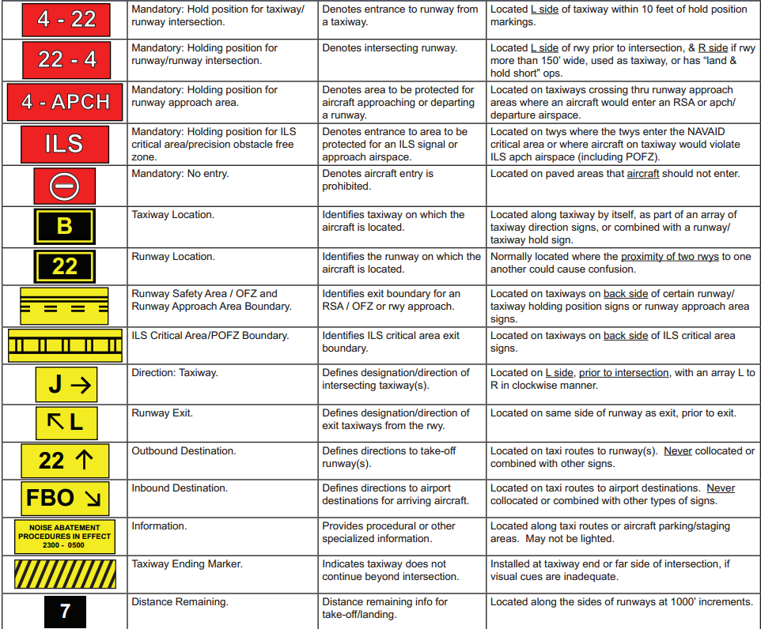

Slide 41
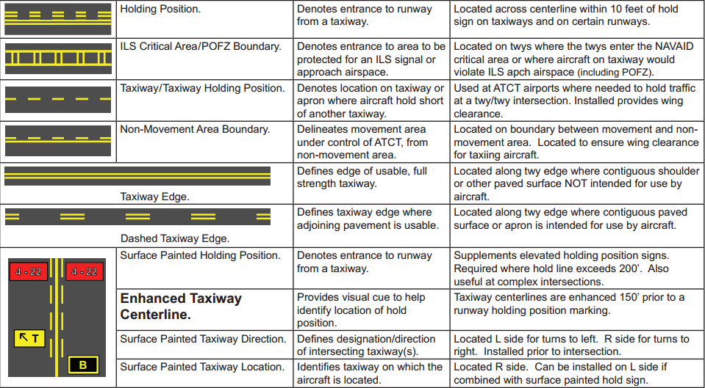

Slide 42
